Slide 1

Bright Coffee Shop Revenue Analysis
Presentation

Slide 2
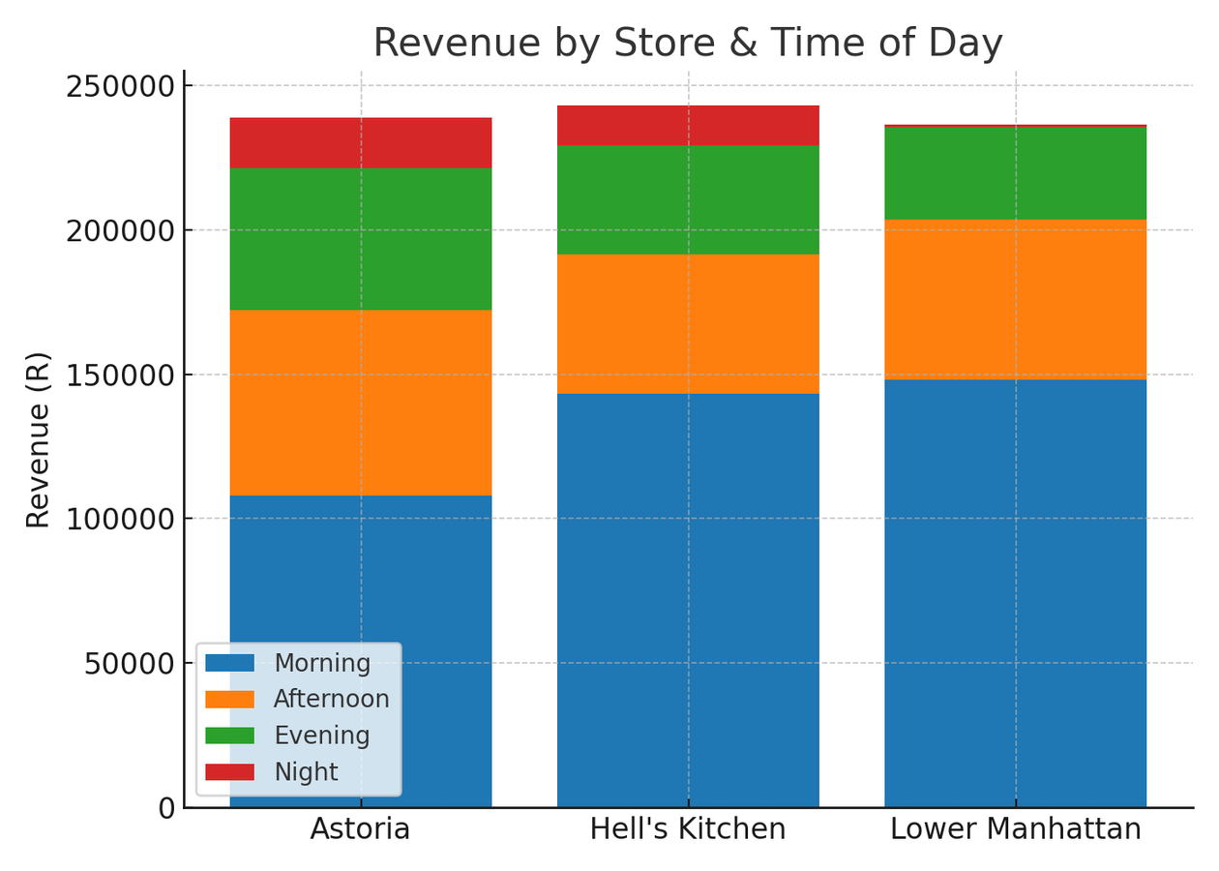
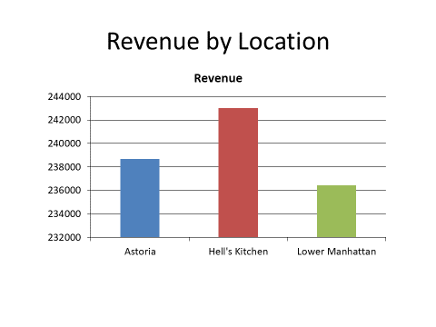
Total Revenue:
R 706 665,00

Slide 3
Analysis
Revenue is evenly distributed across locations, shows consistent performance across all areas.
All three locations have their highest revenue in the morning. Nighttime performs
the worst, Lower Manhattan with extremely low night revenue
Morning is clearly the most profitable period, contributing more than half of total revenue.
Afternoon and Evening contribute moderately.
Highest earning location: Hell’s Kitchen, Lowest earning location: Lower Manhattan

Slide 4
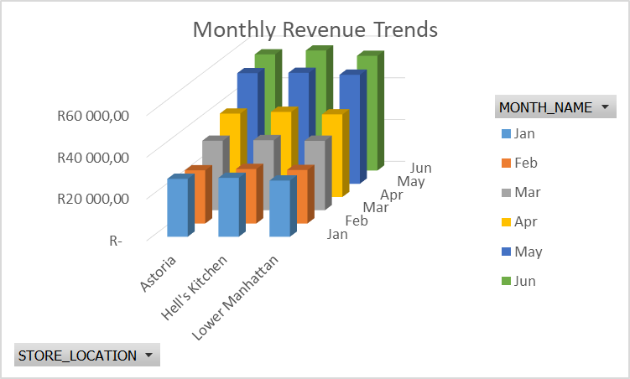
After a small drop in February, revenue steadily grows month by month. May and June are particularly strong performers. This could indicate seasonality change, increased marketing, or better customer engagement in later months.
Morning is clearly the most profitable period, contributing more than half of total revenue.
Afternoon and Evening contribute moderately.
Night is consistently the lowest performer.

Slide 5
Conclusion
The business is heavily dependent on morning traffic. This could indicate People traveling to work or school, customers may have morning habits like picking up breakfast or grabbing coffee. Quick Service in the mornings and shop near transit hubs.
Recommendations
The business should Invest more in morning promotions & product variety. Introduce loyalty programs for morning customers to keep up the sales. Balance staff allocation in the morning to ensure fast service and maximize sales.
As for night try exploring strategies to boost evening/night sales (happy hour, discounts, events). Investigate the low night revenue. If it’s operational, consider extending hours.

